Slide 1


Global Electronics Retailer Analysis
Supervised by: Mennatallah Selim Mohamed
Prepared By:(United Group Team)

Slide 2


Project Name
Global Electronics Retailer Data Analysis
Prepared BY (United Group Team)
Mr. Maged Abdelrazik Ahmed
Mr. Omar Ahmed Elsyed
Mrs. Salma Amr Abdelmotaleb Aly
Mrs. Dena MOHAMED Khalefa
Supervised By :
Mennatallah Selim Mohamed
Training Company By :
AST Company
Group Code: (CAI1_DAT1-G11d Data Analyst Specialist)

Slide 3

Introduction
"Global Electronic retail, which runs a worldwide company to sell different electronics products for its customer. retail time series data for Global Electronic were provided including details on the customer and location, product, sales, store, and delivery In this presentation, we will discuss strategic initiatives to enhance customer, product, sales, and store data .
focusing on key areas such as customer segmentation, product and customer retention strategies .
Objectives
The main objective for this analysis is to create an exploratory dashboard that helps the company for:
Sales and Revenue analysis.
Customer behavior and demographic analysis
Analyze Product performance and Product Categories .
Diagnose store and delivery performance of the company .

Slide 4

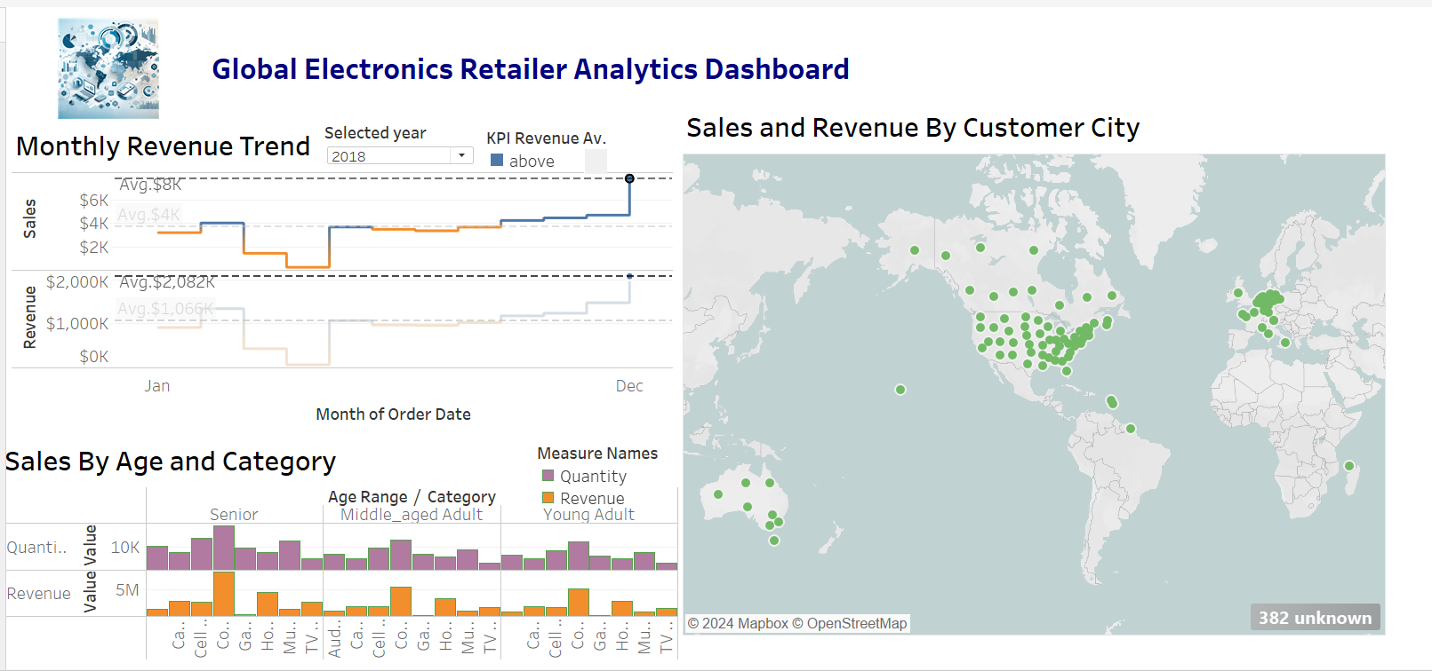
As part of Global Electronics' data analytics team, our task was to conduct a comprehensive EDA to uncover valuable insights from the company’s data. The goal is to provide actionable recommendations that can enhance customer satisfaction, optimize operations, and drive overall business growth.
Customer Segmentation
Geography, Age and Revenue :
"Customer Distribution by Age: Visualized the age distribution of customers top age is in the senior level and top sale product is in Computer .
Customer distribution by state, country, city, : Tree map showed total geographically located and top sale is in the USA.
Also The left pattern showed that the highest monthly revenue generating product in period (Oct–Feb) while the lowest monthly revenue is in (Apr) .
Problem Statement

Slide 5

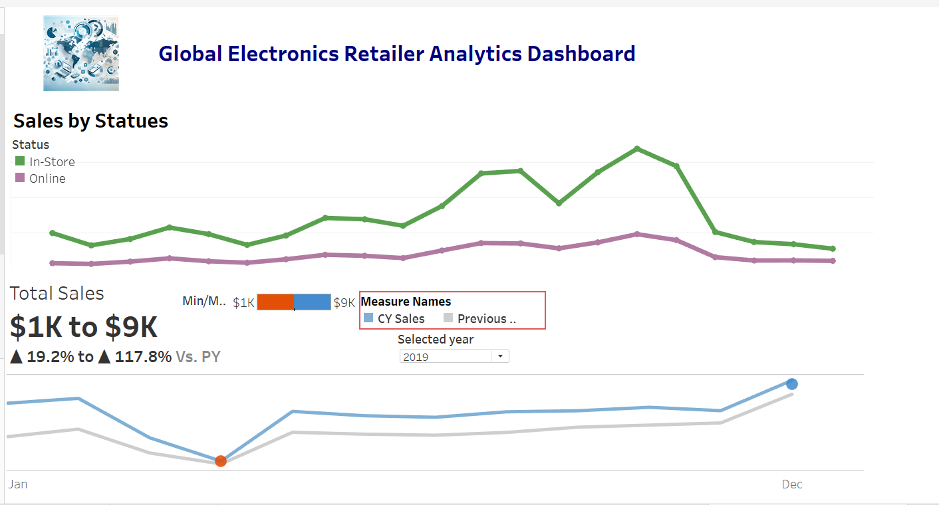
Sales performance
Statues Sales :
"Seasonal Trends: Examination of sales data over time highlighted seasonal fluctuations in demand for electronics products. Based on the data presented, 2019 was the best performing year in terms of order volume and revenue. Also, October to February the following year generated the highest revenue and volume across all years, indicating this was a peak purchasing period.
“Also this graph illustrates whether sales made directly from the store or online generally, customers preferred physical stores to online shopping. highest of the revenue was generated from in-store sales while the remainder from online sales ."

Slide 6

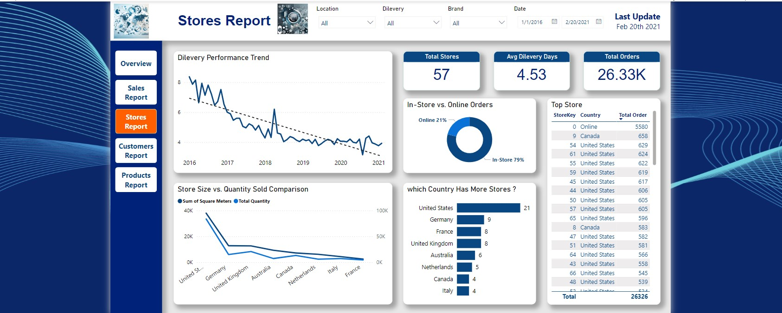

Store Performance
Delivery Performance
"Order delivery times: Matrix data showed the product delivery performance based on a standard 5 day delivery times. The chart includes continents, countries, cities to analyze the performance of delivery."
Store Sales Comparison
The chart compares sales across different stores, especially the top 50 stores were listed to see the top performing store.
Store size vs. sales: the scatter plot analyses to determine if store size (square meters) has any correlation with sales performance. It has been observed that the store size was linearly related to the sales of the store."

Slide 7
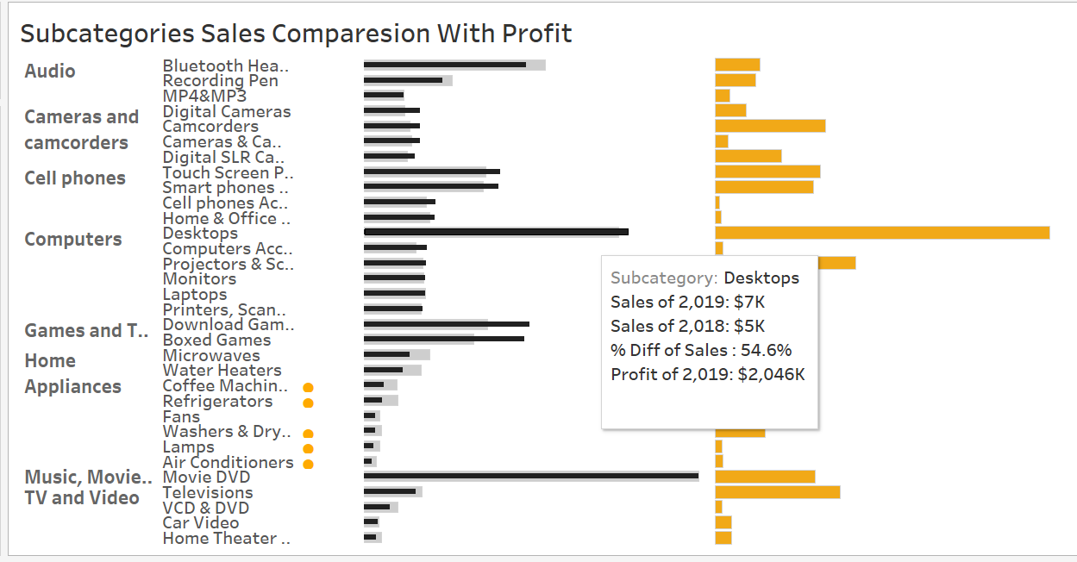
Subcategories Sales Comparison With Profit
"The chart compares between subcategories sales across years , the top highest subcategories sales are computer desktop and movie DVD
also the profit from sales compression across ."

Slide 8


Conclusion
In summary, by focusing on tailored strategies for different customer segments, the comprehensive analysis of Global Electronics, product, sales, and store data has provided valuable insights into key customer segments, top-performing products, and stores.
This analysis has highlighted the significant impact of currency exchange rates on sales and provided actionable recommendations for tailored marketing campaigns, optimized inventory management, enhanced international pricing strategies, and improved store operations. By implementing these recommendations, Global Electronics can enhance customer satisfaction, streamline operations, and drive business growth. The strategic focus on data analytics and sustainable practices will ensure the company remains competitive and responsive to market trends and customer needs and expectations ”

Slide 9
Thank you

